Slide 1
A living document exchanged between neighborhood leaders and stakeholders
Provide Safe and Livable Neighborhoods
May 28th 2015, 5:30 p.m.
Morris Burner Hotel

Slide 2
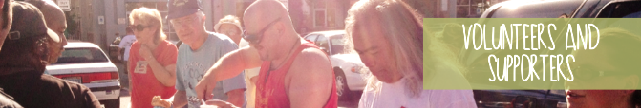
East 4th Street Neighborhood Meeting
Needs and Goals Discussion
  East 4th Serves the Region
  Miscellaneous Aerials
  Reduced Emergency Service Calls
  Safe Zones
  Transportation
  Attractive Public Spaces
  Substance Abuse
  Neighborhood Communication
Business Community
  Public Comfort
  Fair Taxation Policies
Service Community
  Safe Access
  Effective Needs Management
  Engaged Organizations
Government Community
  Public Relationships
  Highest and Best Land Use
  Sustainable Communities
  Intelligence Led Policing
Shared Overflow Providers
  Catholic Charities
  Volunteers of America
  Reno Initiative for Shelter & Equality
  Morill St East of Wells overpass
Upcoming Goals
  Autonomous Collaboration
  Regular Neighborhood Meetings
  Community Pillars
  Council Resolution
  Create Site Requirements
    Artistic Rendering
    Site Sketches
Appendix
  Research Links
  Notes
Remember
  We are good at this

Slide 3
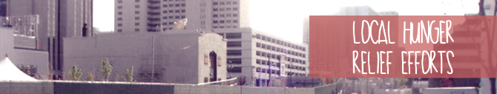
East 4th Street Serves the Region
Needs and Goals Discussion
  Gathering of Regional Service Providers
  Reduced Emergency Service Calls
  Safe Zones
    Safe Environment for the Vulnerable
    Public Feeding
    Personal Property Protection
    Families without Homes
    Bathroom Facilities
    Clean Water
  Social Fabric to Engage
    Transportation
    Substance Abuse
    Inadequate Housing
  Attractive Public Spaces
    Blight Reduction
    RTC Upgrades
    Cleanup
  Neighborhood Communication
    Monthly Meetings Tapering to Quarterly (Explore the West of Wells neighborhood group)

Slide 4
Community Assistance Center
Needs and Goals Discussion

Slide 5
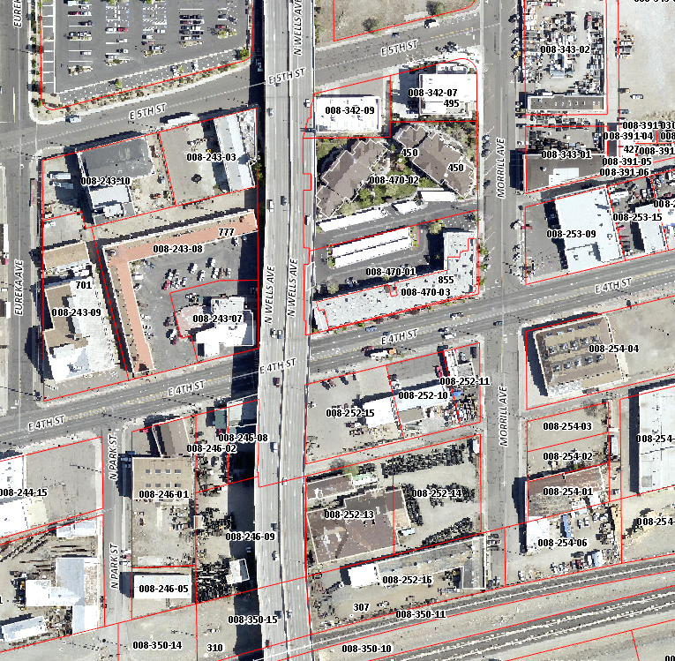
Wells Overpass View
Needs and Goals Discussion

Slide 6
Multiagency Facility + Solution Options
Needs and Goals Discussion

Slide 7
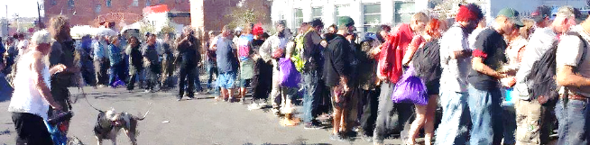
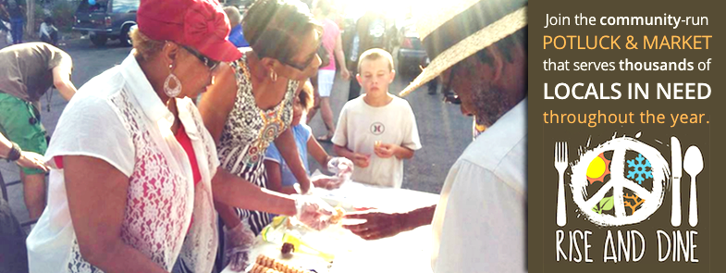
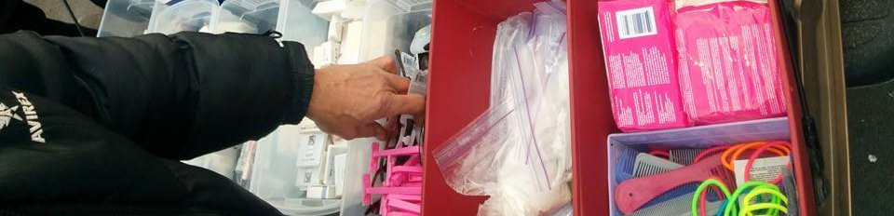
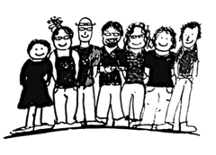
Reno Initiative for Shelter and Equality
Needs and Goals Discussion
RISE and Dine
With the help of our supporters, RISE feeds & clothes thousands of Reno’s most poverty-stricken throughout the year.
Volunteer Programs
Over 500 people a year team up and help run RISE programs
Free Store
RISE distributes clothing and hygiene items with a value of over $10,000 to those needing emergency aid each year.
Community Relationships
33 companies have contributed to RISE efforts to bridge the gaps between our citizens.

Slide 8
Volunteers of America
Needs and Goals Discussion
Men's Shelter
Volunteers of America's Men's Shelter for homeless men.
Family Shelter
An emergency shelter for families located at Reno's Community Assistance Center.
Affordable Housing for Seniors
Volunteers of America manages for seniors 62 and older.
Women's Shelter
The Volunteers of America Women's Shelter provides emergency shelter to homeless women.
Mental Health Support Services
ReStart is a Volunteers of America program offering clinical and non-clinical services for eligible individuals and families who are homeless or at risk of homelessness and have a mental illness

Slide 9
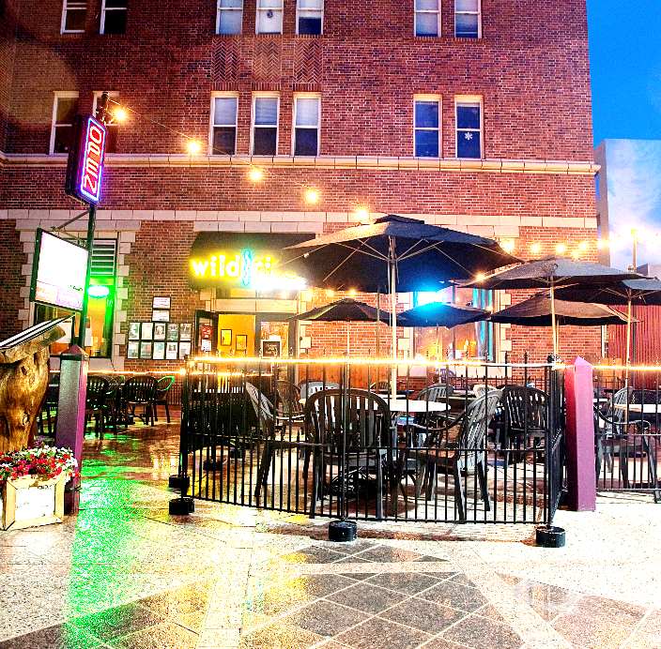

Energizing Business Environment
Business Community
Public Comfort
Secure public spaces that serve all our communities needs.
__________________________
__________________________
__________________________
__________________________
Fair Taxation Policies
Properly serve those facing poverty with shared regional tax burden for shared regional challenges.
__________________________
__________________________
__________________________
__________________________

Slide 10
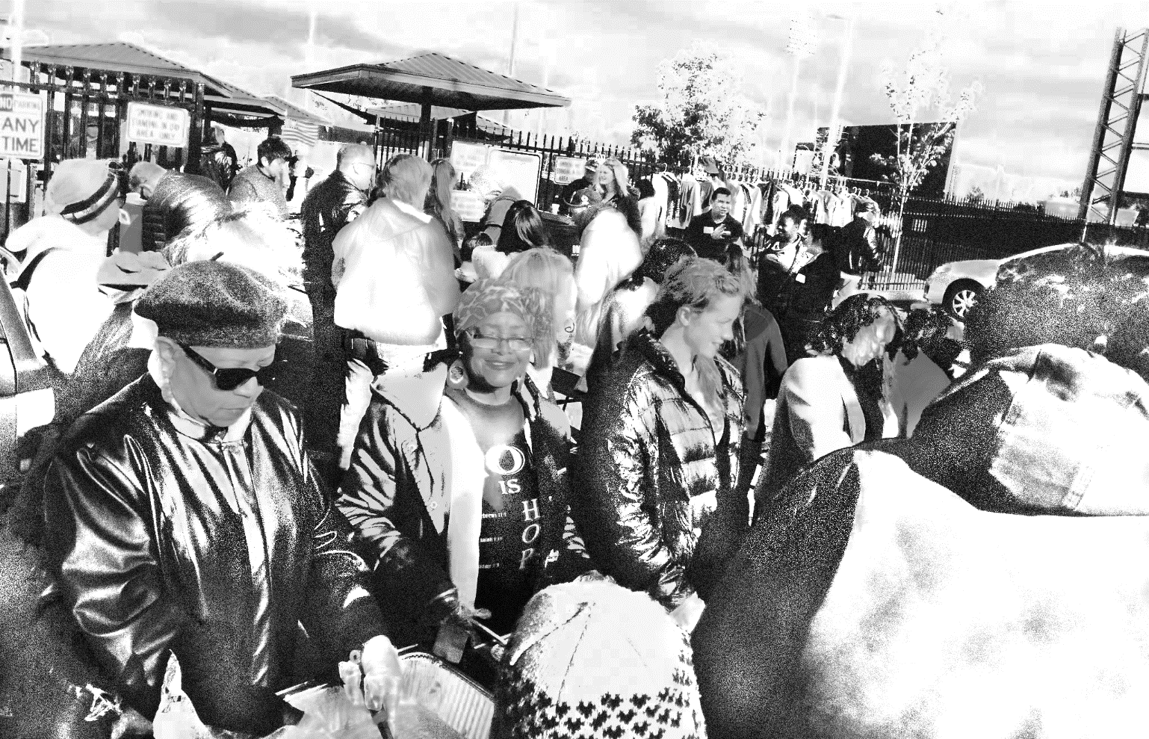
Safe and Empowering Relationships
Services Community
Community Orgs
__________________________
__________________________
__________________________
__________________________
Spiritual Groups
__________________________
__________________________
__________________________
__________________________

Slide 11
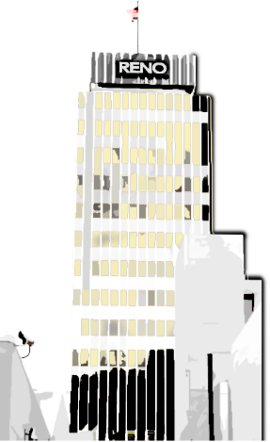
Facilitation and Security
Government Community
Public Relationships
Highest and best land use
Adequate services for our population
Sustainable Communities
Add to the value of our region
__________________________
__________________________
__________________________
__________________________

Slide 12
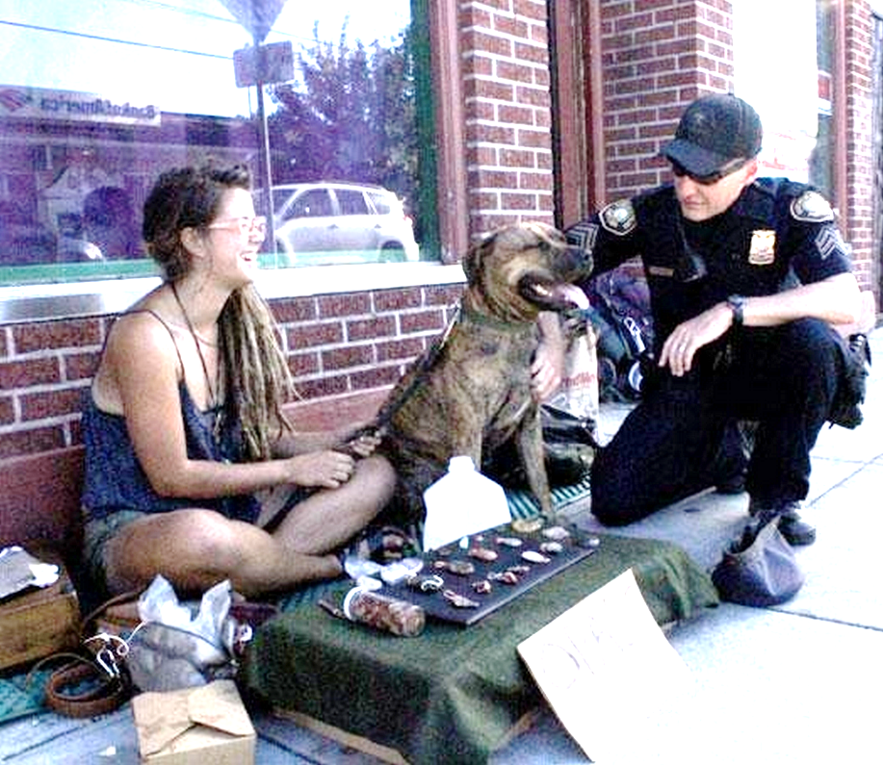
Facilitation and Security
Government Community
Intelligence Led Policing
Relationship/Partnerships
Community Policing
De-escalation Teams
Data and Evidence
Case Studies
Long Term Goals
Crime Prevention
Problem Solving

Slide 13
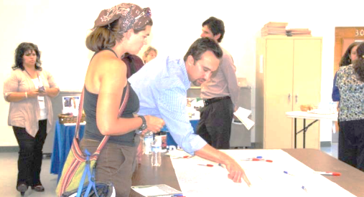
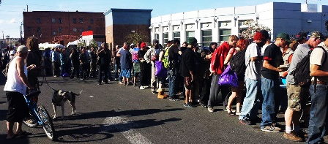
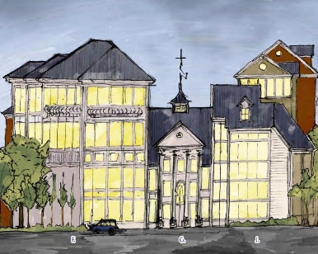
Where do we go from here?
Upcoming Goals
Regular Neighborhood Meetings
  Monthly to start
  Quarterly once communications are established
Create Renderings
  Overflow site
  Kitchen support
  Map of services
  Map of housing

Slide 14
Research Links
Appendix
East 4th Street Walking Tour - http://renohistorical.org/tours/show/7#.VVEUIPlVhBc
Positively 4th Street - http://www.positively4thstreet.org/
RTC bus - http://www.rtcwashoe.com/streetshighways/documents/SummaryReportCorridor.pdf#page=2
East 4th Street TOD Corridor Plan - http://www.reno.gov/home/showdocument?id=43526
Men’s Shelter, Reno - http://www.voa-ncnn.org/mens-shelter-reno
Hud Listed Shelters - http://portal.hud.gov/hudportal/HUD?src=/states/nevada/homeless/shelters
Volunteers of America Northern Nevada - http://www.voa-ncnn.org/northern-nevada
Catholic Charities of Northern Nevada - http://ccsnn.org/
West of Wells Neighborhood Group - http://www.westofwells.com/
RTC RAPIC Transit 4th St/Prater - https://4thprater.files.wordpress.com/2011/07/narrative4thprater.pdf
__________________________
__________________________
__________________________
__________________________

Slide 15
Notes
Appendix
__________________________
__________________________
__________________________
__________________________
__________________________
__________________________
__________________________
__________________________
__________________________
__________________________
__________________________
__________________________
__________________________
__________________________
__________________________
__________________________
__________________________
__________________________
__________________________
__________________________
__________________________
__________________________
__________________________
__________________________
__________________________
__________________________
__________________________
__________________________
__________________________
__________________________
__________________________
__________________________

Slide 16
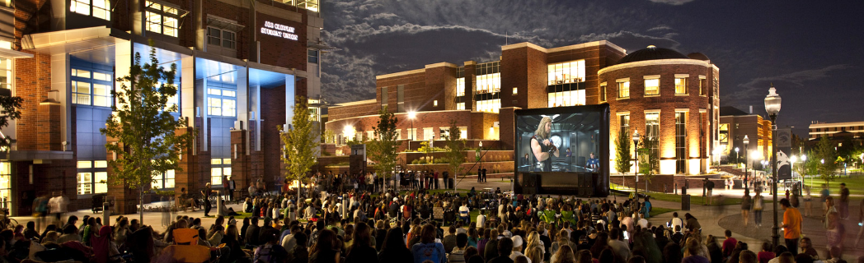
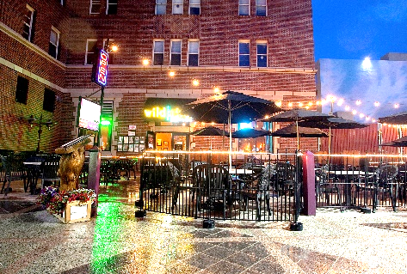
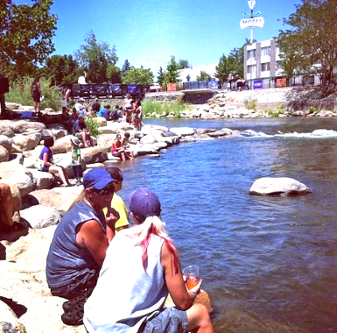
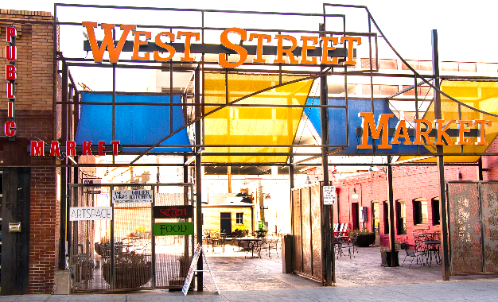
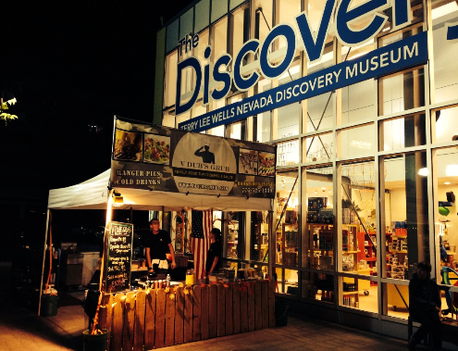
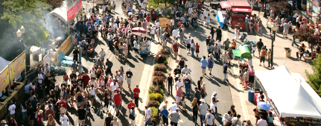
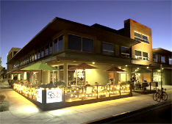
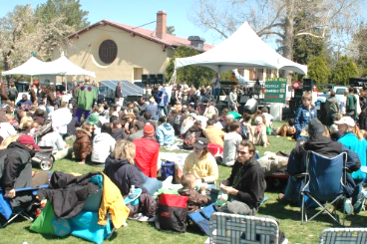
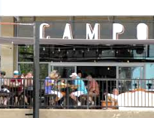
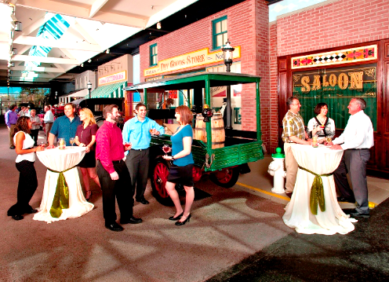
We are Good at Public Space
Remember

