Slide 1
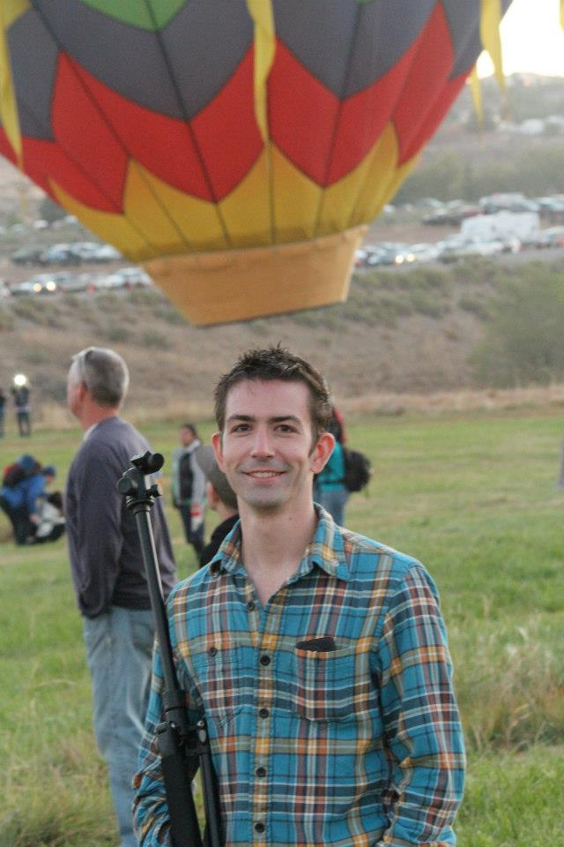
Presenter
Jay Kolbet-Clausell
775-391-0742
jay@renosparks.org

Slide 2
Know the Data
RenoSparks.org

Slide 3
Deal with People
Katrina

Slide 4
Care for the Streets
NABs

Slide 5
Know the Data
I’m available to help
Wednesday - Friday

Slide 6
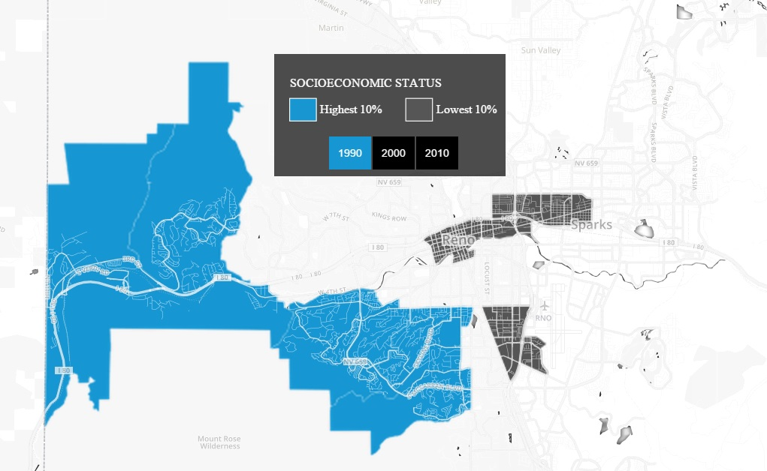
Urban.org
Source:
http://datatools.urban.org/features/ncdb/top-bottom/index.html#7/42.004/-94.026

Slide 7
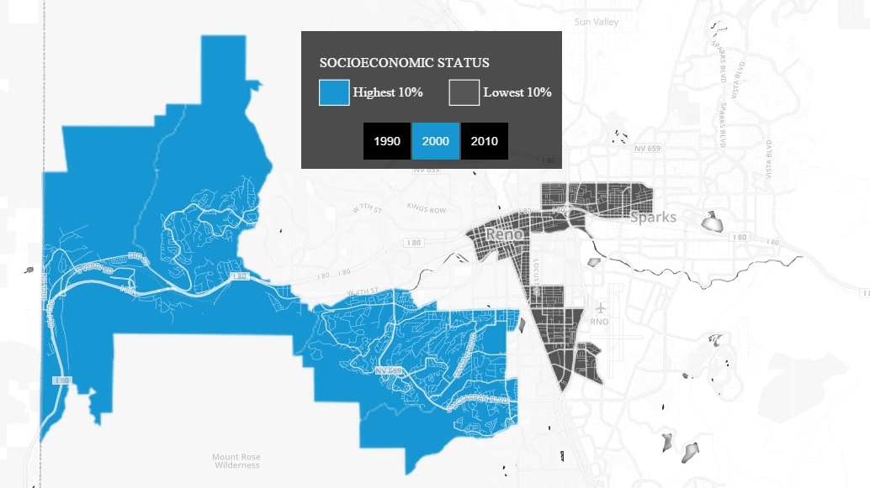
Urban.org

Slide 8
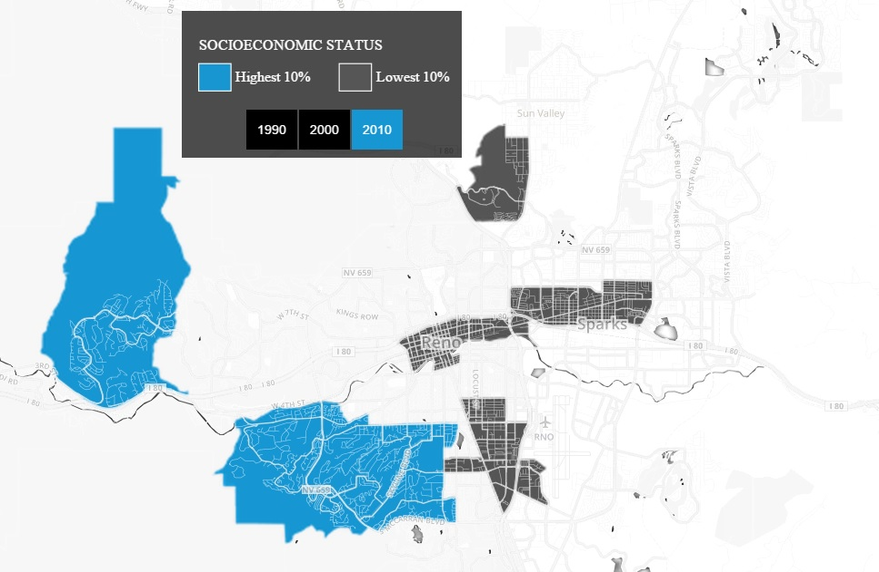
Urban.org

Slide 9
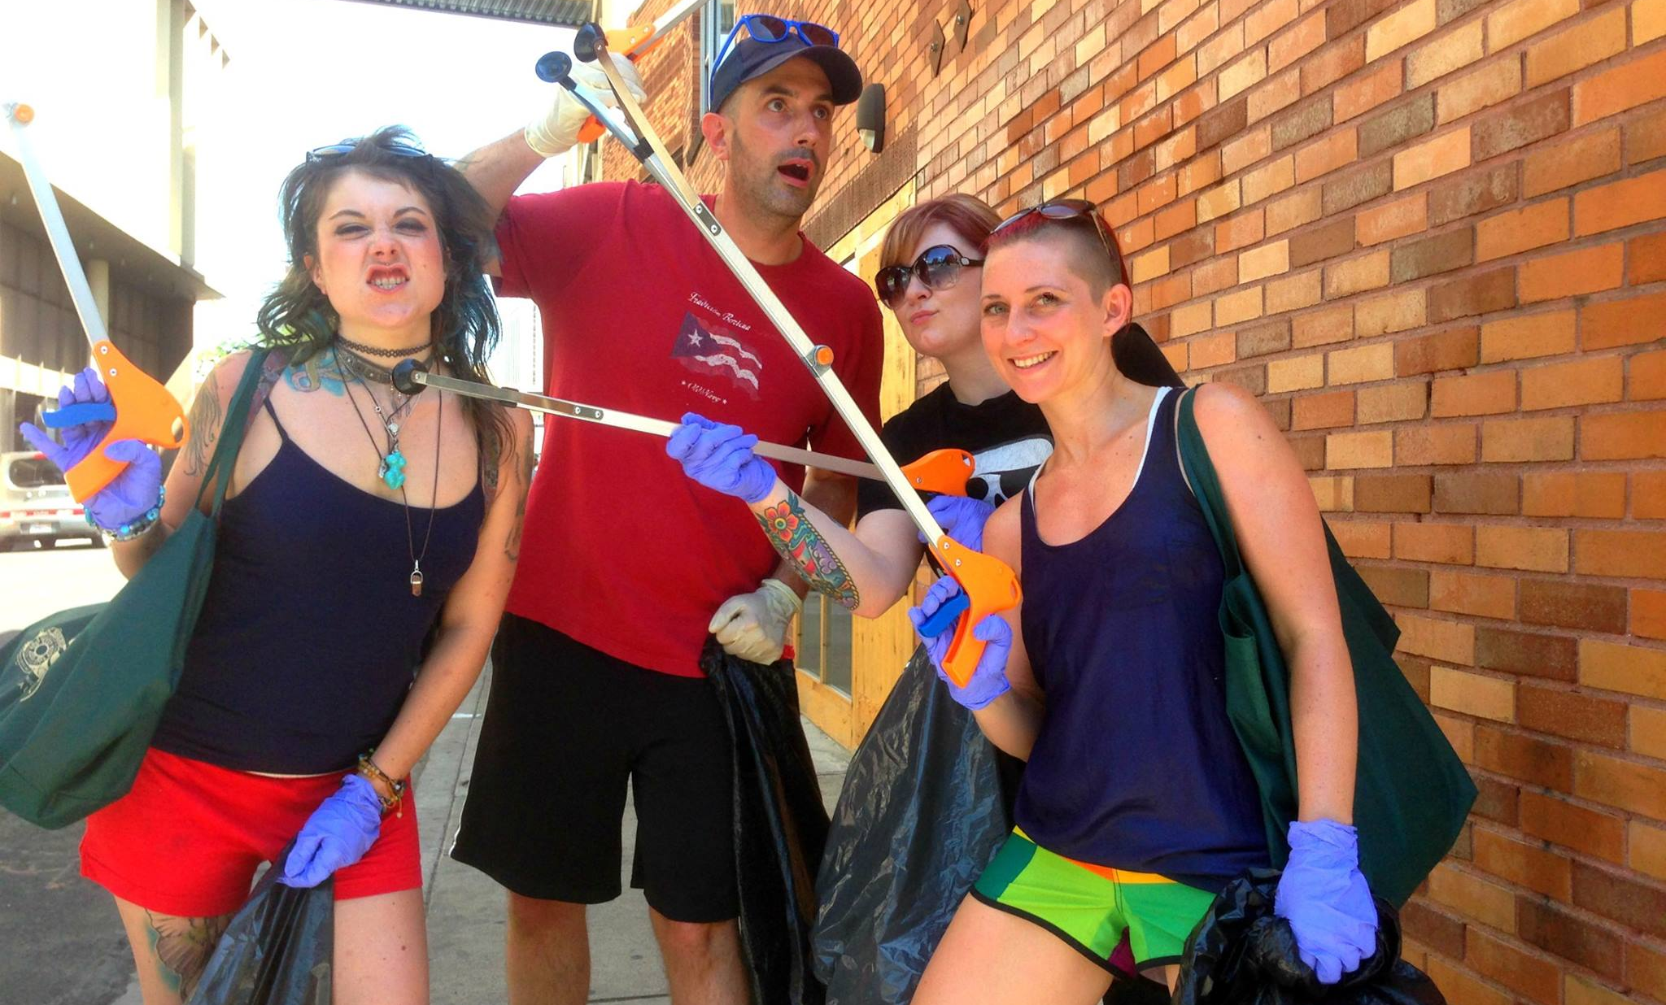
Care for the Streets
KTMB.org

Slide 10
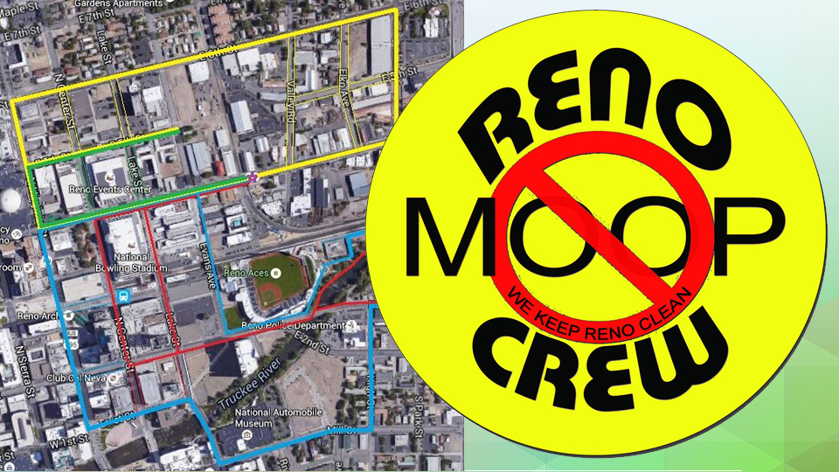

Slide 12
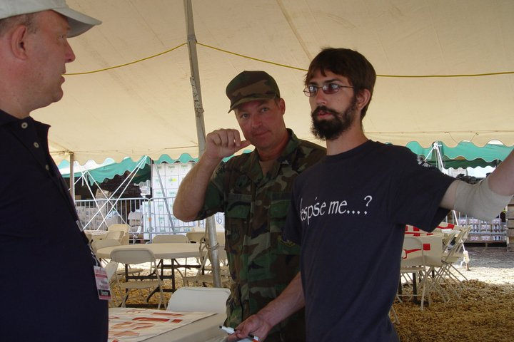
Deal with People

Slide 13
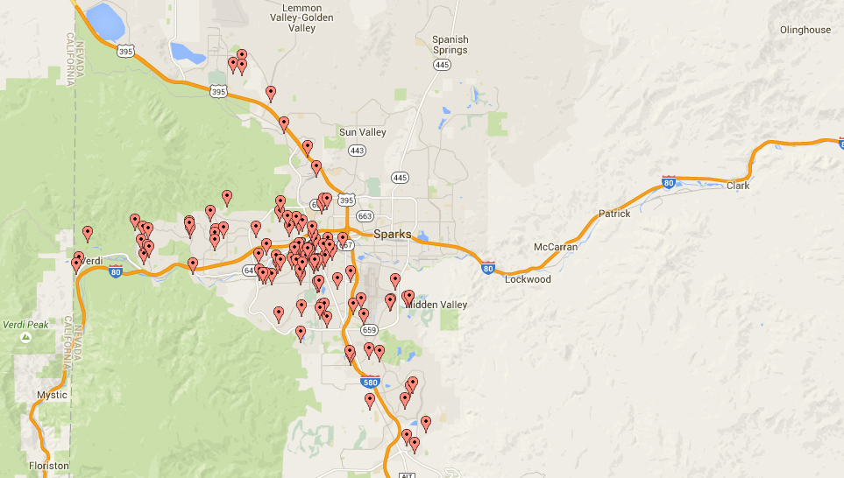
Neighborhood
Advisory Board
Applications
From Reno
Public Records
NABs

Slide 15
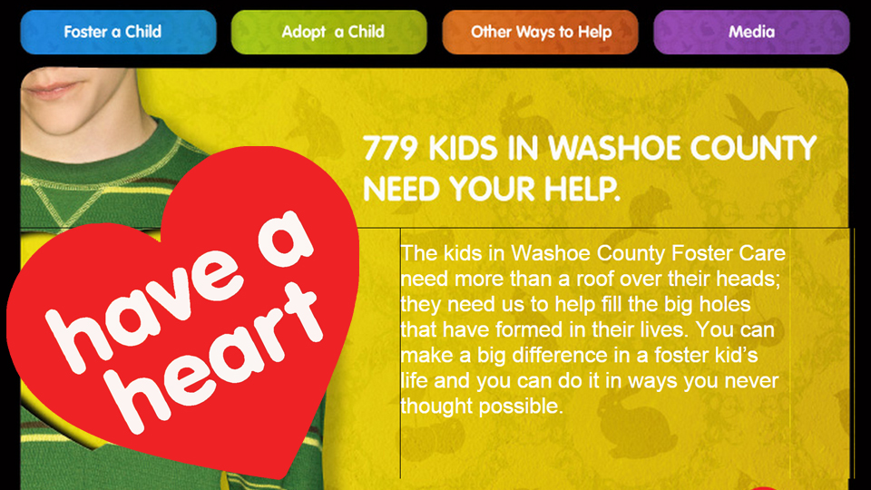

Slide 16
Presenter
Jay Kolbet-Clausell
775-391-0742
jay@renosparks.org

